Slide 1
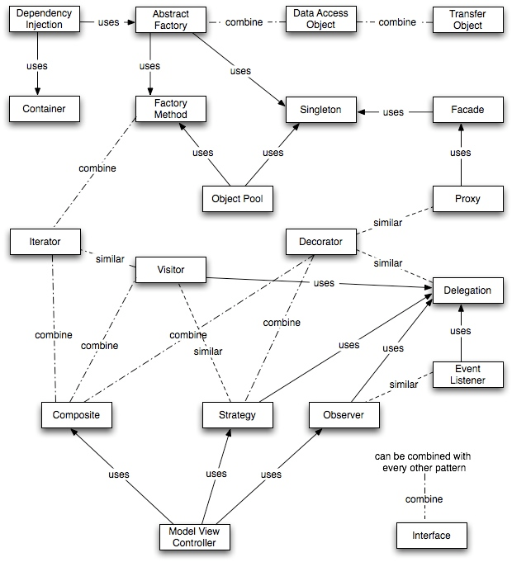
Design Patterns
Notes:
I work for Tyson Foods, as a Lead Programmer Analyst for the Program Management Office. There I am one of the administrator for our Project Server 2010 implementation and Lead Developer on our project management tools we have created in house. I am also a 3 time Microsoft ASP.NET MVP.
Let’s take look at what you are here about.
How many of you have heard of NuGet?
How many of you are already using it on your projects?
If you answered no, to both or either of those we are going to fill in the missing pieces for your.
If you answered yes, then you might know some of this and if we have time we will talk about hosting your own NuGet server and why.
Let’s look at the agenda.

Slide 2
About Design Patterns
General, reusable solutions to common problems
Not a complete, finished solution
A template, recipe, or approach to solving certain problems
Each has a specific name, so we can discuss common elements of design using a common vocabulary

Slide 3
Common Design Patterns
Singleton
Strategy
Repository
Proxy
Command
Factory

Slide 4
Singleton: Intent
Ensure a class has only one instance
Make the class itself responsible for keeping track of it’s sole instance
“There can be only one!”
http://csharpindepth.com/Articles/General/Singleton.aspx

Slide 5
Singleton: Structure
Not Thread Safe
Code Sample

Slide 6
Singleton: How it is used
Call methods on instance directly
Assign variables to instance
Pass as parameter

Slide 7
Singleton: Thread Safe Version
The LazySingleton

Slide 8
Resources
NuGet Official Site: http://nuget.org
NuGet Dev Site: http://nuget.codeplex.com
NuGet Docs: http://bit.ly/bYEwEx
NuGet Package Explorer: http://bit.ly/fYIHHi
NuGet Copy Script: http://bit.ly/gTJhPi
My Blog: http://jaysmith.us
Twitter: @JaySmith
Email: Jay@jaysmith.us

